Slide 1
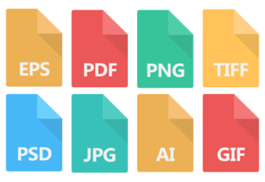
Advanced higher Graphic communication
DTP File Types

Slide 2
Learning intentions & success criteria
Learning Intentions
Overview of the different graphic file types used in industry.
Success Criteria
State the name of different graphic file types.
Describe and explain the different file types, their purpose and use.

Slide 3
FILE TYPES
There are two categories that file types in the course fit into:
Graphic Media File Types
Technical Graphic File Types

Slide 4
JPEG (Joint Photographic expert group)
Graphic Media
What is special about this file?
Raster image file.
A commonly used method for compression of digital image files.
Can be optimised to find the right balance of small file size and high quality.
What is it used for?
Most commonly used image format by digital cameras and mobile devices.
Most common method of storing and sending images over the internet.
Ideal for websites due to small file size but high quality image.

Slide 5
Png (portable network graphic)
Graphic Media
What is special about this file?
Raster image file.
Can have transparent background and generally larger and higher quality than JPEG.
Not ideal for high quality professional prints.
What is it used for?
Web use where transparent background is preferred to allow background colours to show.
Logos, icons, overlay images.

Slide 6
BMP (Bitmap image file)
Graphic Media
What is special about this file?
Raster image file.
Stores colour data for each pixel in the image without any compression.
Results in crisp, high-quality graphics but produces large file sizes.
What is it used for?
Hard copy print outs – high quality results due to no compression.

Slide 7
Pdf (portable document format)
Graphic Media
What is special about this file?
Multi-platform file format; works on all computers.
Regardless of creation software/platform, fonts and graphics are ‘flattened’ into a single file.
Normally reduces file size from original creation software.
What is it used for?
Sending documents (external storage or e-mail) that can be read on any platform.
Doesn’t require individual computers to have matching hardware, OS or software types.

Slide 8
Ai (adobe illustrator file)
Graphic Media
What is special about this file?
Vector graphic file created using Adobe Illustrator.
Due to algorithm based image creation, produces super crisp, high quality images.
Can be scaled up or down without loss of quality.
What is it used for?
Images that can be used on small or large scales – therefore no loss in quality at either end.
Logos, illustrations, graphics and general high quality print outs.

Slide 9
Wmv (windows media video)
Graphic Media
What is special about this file?
Video file type developed by Microsoft.
A file type which compresses video formats for optimum storage.
What is it used for?
Originally designed as a file format for internet video streaming applications.
Simple file playback but doesn’t allow other data (subtitles etc.)

Slide 10
Avi (audio video interleave)
Graphic Media
What is special about this file?
Video file type developed by Microsoft.
Contains both audio and video data in a file container, allows for synchronous playback.
Umbrella file format to be used for various types of video playback (DivX, MPEG etc.)
What is it used for?
Popular file format for standard definition video playback on PC’s.
AVI container files can also include additional features such as subtitles and chapters.

Slide 11
3gp (3rd generation partnership project – 3gpp)
Graphic Media
What is special about this file?
Multimedia file container format used by 3G compatible mobile phones and devices.
What is it used for?
Transmitting text, audio and video between 3G phones/devices and over the internet.

Slide 12
MOV Quicktime file formats
Graphic Media
What is special about this file?
Multimedia format developed by Apple.
Can handle various forms of digital video, picture, sound, panoramic images and interactivity.
What is it used for?
Playback of a variety of digital video/audio files and formats.
Standard/default player associated with iTunes and most MAC systems.

Slide 13
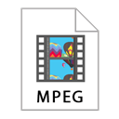
MPEG (Moving picture experts group)
Graphic Media
What is special about this file?
An international standard for encoding and compressing video images.
What is it used for?
It is used to store films on CDs.
Video data is usually 30 frames per second (fps).

Slide 14
EPS (Encapsulated postscript)
Graphic Media
What is special about this file?
It is a file extension for a graphics file format used in vector-based images such as Adobe Illustrator.
What is it used for?
It may contain 2D vector graphics, bitmap images and text.
Also include an embedded preview image in bitmap format.

Slide 15
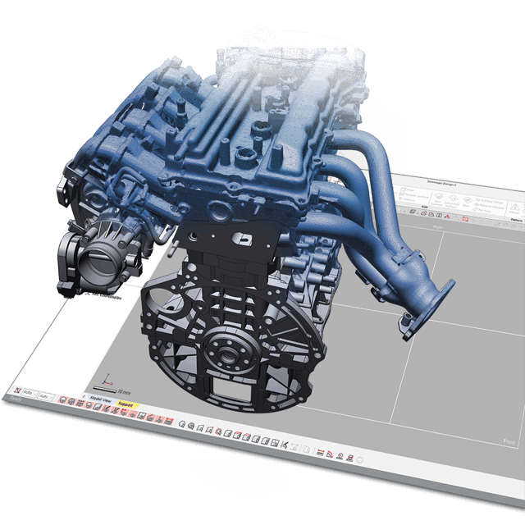
Stl (Standard Tessellation Language/ stereo lithography file format)
Technical graphic
What is special about this file?
The STL file format has become the Rapid Prototyping industry's defacto standard data transmission format. This format approximates the surfaces of a solid model with triangles.
What is it used for?
This file format is supported by many other software packages; it is widely used for rapid prototyping, 3D printing and computer-aided manufacturing.

Slide 16
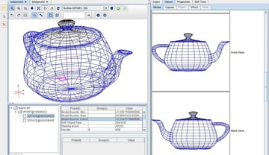
Dxf (direct exchange format)
Technical graphic
What is special about this file?
AutoCAD DXF is a CAD data file format developed by Autodesk for enabling data interoperability between AutoCAD and other programs.
What is it used for?
A DXF file is a binary representation of a drawing file. It is often used to share drawing data between other CAD programs.

Slide 17
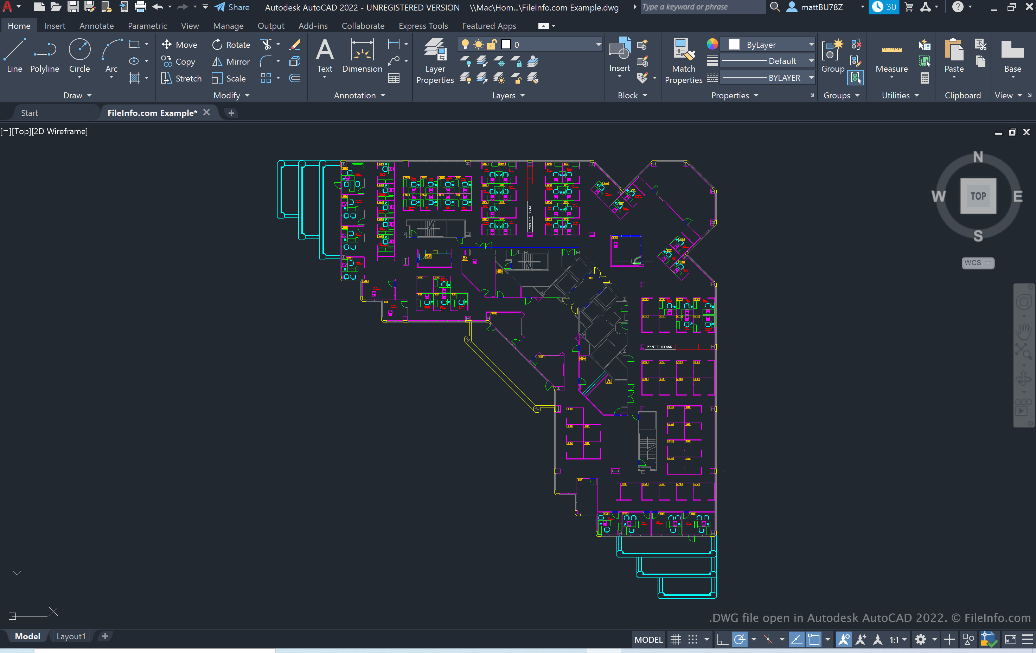
Dwg (Drawing format)
Technical graphic
What is special about this file?
DWG is a binary file format used for storing two and three dimensional design data and metadata.
What is it used for?
Derived from “Drawing”, DWG is a binary file format used for containing 2D and 3D design data. DWG files are basically CAD (Computer Aided Design) drawings consisting of vector image data and metadata written with binary coding. It is the native format of most CAD applications, specially AutoCAD.

Slide 18
Vrml (virtual reality modelling language)
Technical graphic
What is special about this file?
It is a file format for describing interactive 3D objects and worlds to be experienced on the world wide web (similar to how HTML is used to view text).
What is it used for?
VRML is used to illustrate 3-D objects, buildings, landscapes or other items requiring 3-D structure

Slide 19
Eps (encapsulated post script / 3D studio file)
Technical graphic
What is special about this file?
It is essentially a graphics format for vector images that Adobe Illustrator uses, much like a photographic image file format is a JPEG.
What is it used for?
EPS has been considered a good choice of format for vector graphic illustrations intended for high-resolution or large-scale printing and commonly used for printing to PostScript printers and image setters. EPS files are typically created and edited in illustration programs such as Adobe Illustrator or CorelDRAW.

Slide 20
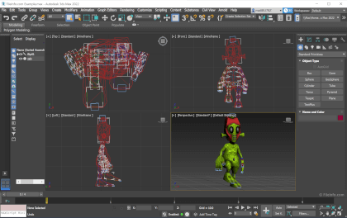
3DS (encapsulated post script / 3D studio file)
Technical graphic
What is special about this file?
The 3DS file extension is short for 3D Studio, and it stores information on the makeup of 3D vector graphics.
This includes mesh data, material attributes, camera and lighting information, and more.
3DS is an old binary-based file format, which means it’s restricted to descriptors rather than the actual image itself. It does, however, allow for faster retrieval of files when sharing.

